Slide 1
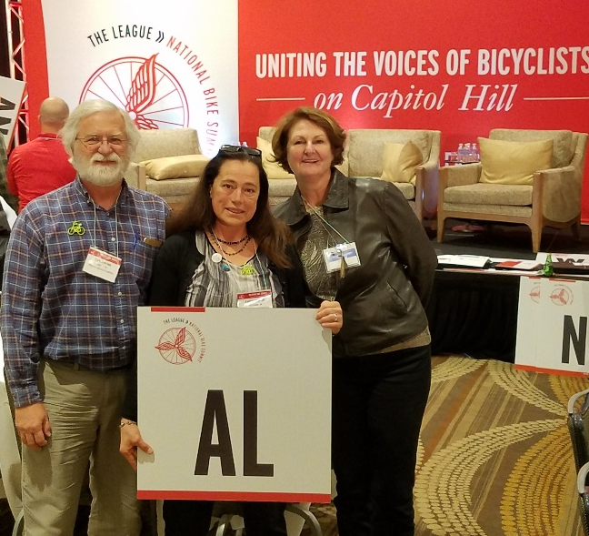
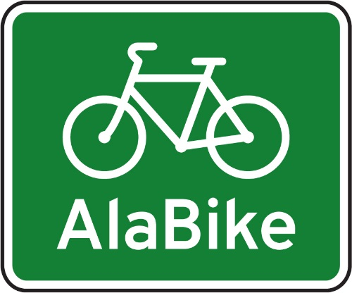
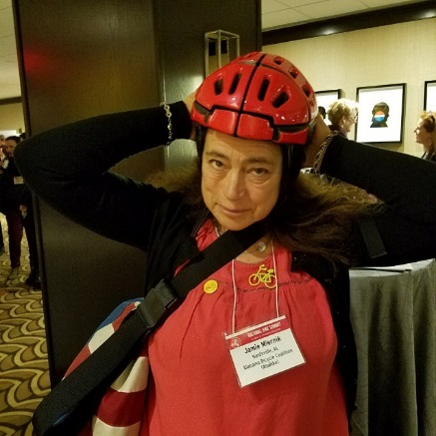
AlaBike Report National Bike Summit 2018

Slide 2
What did we do, what did we learn?
National Bike Summit 2018
Current Trends in Cycling
Session Notes
Legislative asks for US Congress
Lobby Day
Active Transportation Leadership Institute
Bicycle Mayor Initiative

Slide 3
National Bike Summit 2018
Three AlaBike BOD attended the NBS on their own dime this year.
One registration fee ($475) was budgeted and paid for one registration
There was very little swag, fewer sponsors and fewer attendees (possibly less than 500) this year, but all the usual NBS events and expectations were met.
There was a nice array of social gatherings and guided bike rides offered
Lots of informative sessions and speakers
Lobby Day attendance was lighter than usual, but the Alabama delegation visited all nine Congressional offices

Slide 4
Current Trends in Cycling
“Bike Partisan” Bicycle advocacy transcends party affiliations
Electric bikes were quite the topic, especially for legislation needed to better define them
Docked versus “Dockless” Bike Share was being piloted in DC, so many people had the opportunity to weigh in on the pros and cons
A Federal Gas Tax hike was discussed although a bill has not yet been proposed

Slide 5
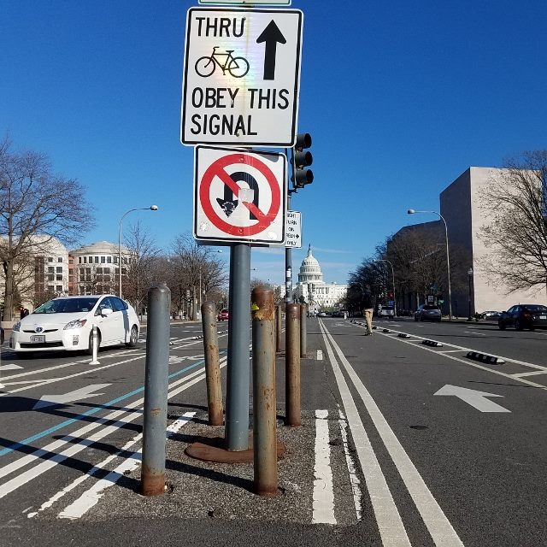
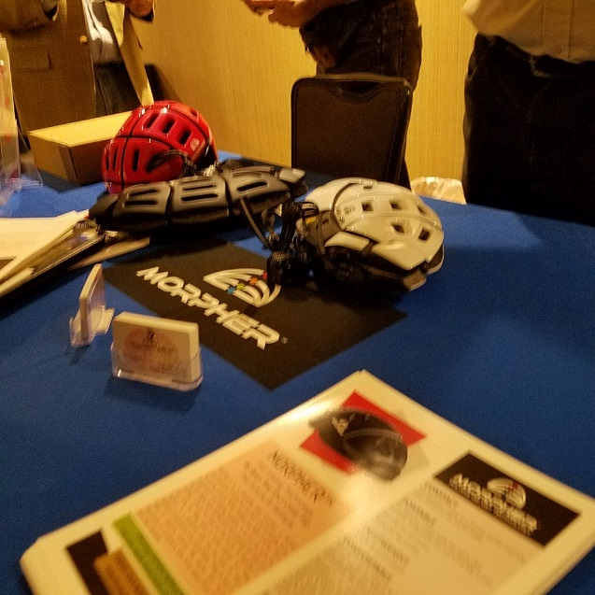
Current Trends in Cycling
Folding helmets great for travel!
Center bike lanes on Pennsylvania Ave =>>

Slide 6
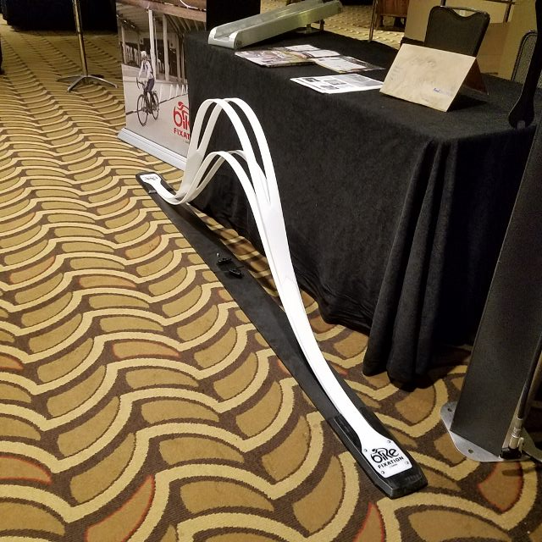
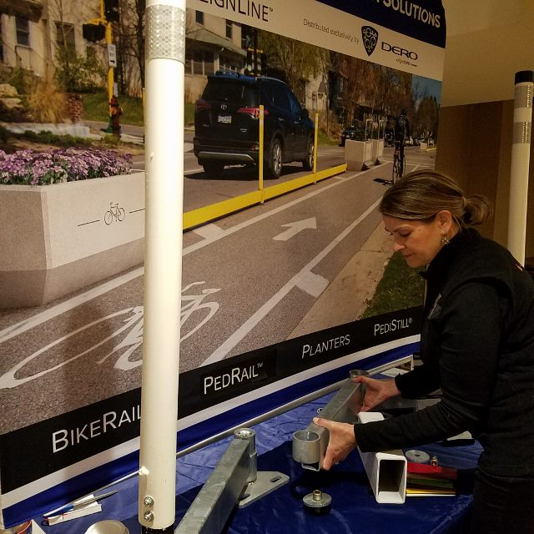
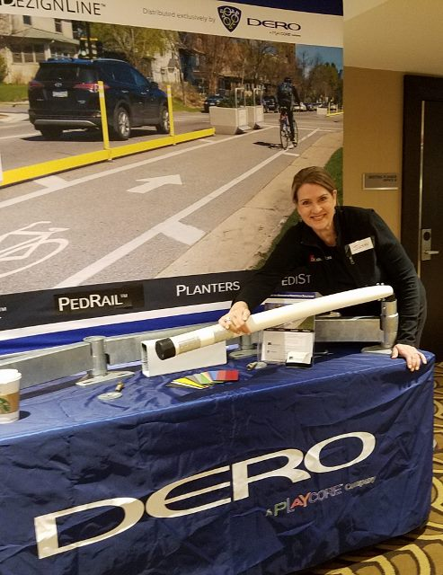
Current Trends in Cycling
Saris
Separated/Protected bike lane barriers
Dero
Permanent
Temporary

Slide 7
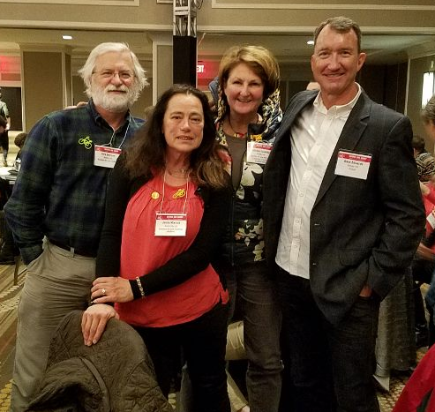
Session Notes
National Geographic Mobile Workshop
Bringing the Circus to Town – Fundraising
Bicycle Tourism – CycleLife HQ
Grant Writing Tips
LAB News
AL delegation with Primalwear CEO Dave Edwards

Slide 8
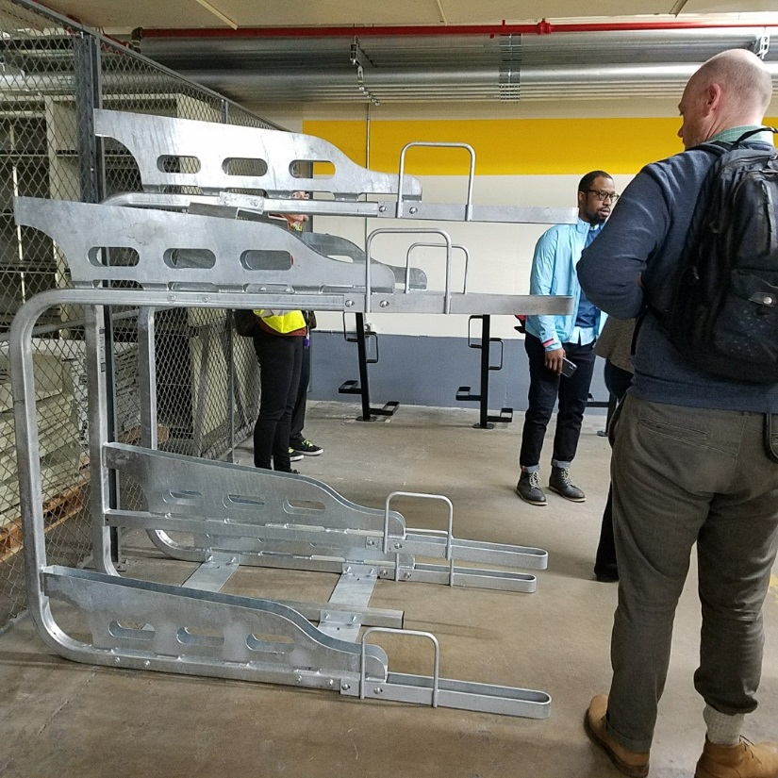
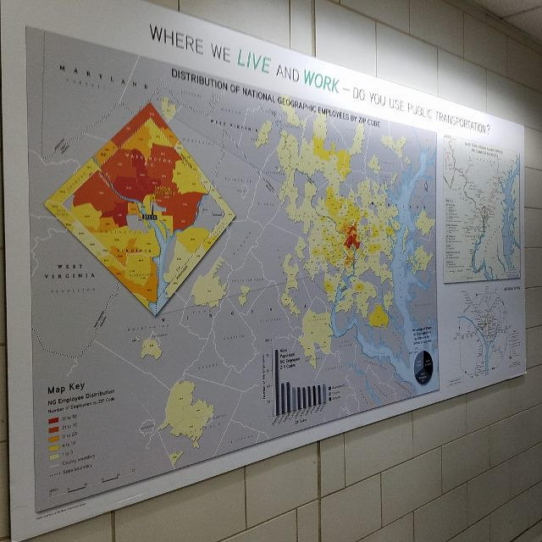
National Geographic Mobile Workshop
We took a bike ride to Nat’l Geo DC office to marvel at their commitment to Cycling commuting.
They track, offer incentives, and encourage riding.
They make changes. This bike rack was a reject =>> Too tall! The man is 6’2”

Slide 9
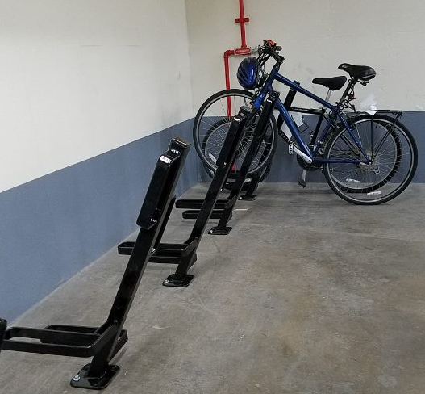
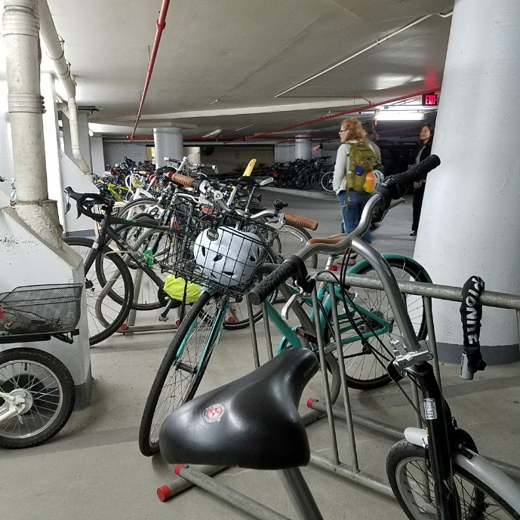
National Geographic Mobile Workshop
They make changes.
Old Parking in the ramp
New Parking Room

Slide 10
Bringing the Circus to Town – Fundraising
This topic was presented by John Yeast of New Belgium Brewing, who was a major sponsor of the Summit.
He spoke of successes with “Tour de Fat” which was a successful fundraiser New Belgium has been sponsoring all over the US for the past three years.
Tips: Develop personal relationships with sponsors, Measure stuff for future reference, and Music is important
He facilitated group discussion and interchange about the session participant’s successful events and why they were successful

Slide 11
Bicycle Tourism – CycleLife HQ
Some current figures on Bicycle Tourism in the US were presented:
$83 billion for cycling tourism of $374 billion in all outdoor tourism, so nearly a quarter of tourism dollars spent; this does NOT include bike and accessory sales
$13 billion in taxes are collected for all of cycling expenditures
Touring cyclists spend about 40% more than typical tourists
CycleLife HQ is a new cycling touring platform that provides info for the US and Australia and is expanding to destinations world-wide.
Representatives from Adventure Cycling Assoc. spoke about the National Bike Route System.

Slide 12
Grant Writing Tips
Four useful websites were provided to search for applicable grants:
Government sites:
https://www.grants.gov/
Foundation Grants:
NCCS.urban.org ( Nat’l Center for Charitable Statistics)
Foundationcenter.org/ask-us/find-us
https://www.cof.org/community-foundation-locator (finds grants by County!)

Slide 13
LAB News
LAB will be presenting details to LCIs April 23 via a webinar, about “Bicycle Friendly Driver Training”. LAB is impressed with and has permission to roll out the “Fort Collins Curriculum” to all to use.
LAB has a new “HUB” communication tool in searchable format.
LAB’s “Report Card” for Alabama: (We bumped up to 39th from 49!) http://bikeleague.org/sites/default/files/BFS2017_ReportCard_Alabama.pdf

Slide 14
Legislative asks for US Congress
Bicycle advocacy is “Bike Partisan”.
We learned a lot about Federal Legislation
Possible federal gas tax hike
Tiger Grants: http://bikeleague.org/sites/default/files/NBS18_FactSheet_TIGER.pdf
Infrastructure Planning: http://bikeleague.org/sites/default/files/NBS18_FactSheet_Infrastructure.pdf
Access-based Planning H.R. 4241: http://bikeleague.org/sites/default/files/NBS18_FactSheet_HR4241.pdf
TAP Funding: https://drive.google.com/drive/folders/1FwgIuCEl3JZm6PdNsjI9oEeWq8n-xTyG

Slide 15
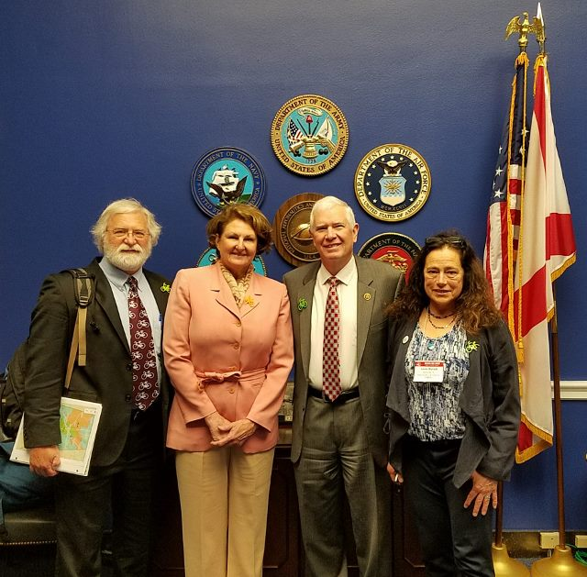
Lobby Day
The AlaBike/Alabama delegation managed to meet with staff or Congressmen at all nine Alabama Congressional offices.
The Alabama delegation had constituents from District 3 &5; Representatives Rogers and Brooks.
The first meeting was 30 minutes with Mo Brooks, who represents Alabama 5th district. He said he’d be willing to support a Gas Tax hike to support some transportation projects.

Slide 16
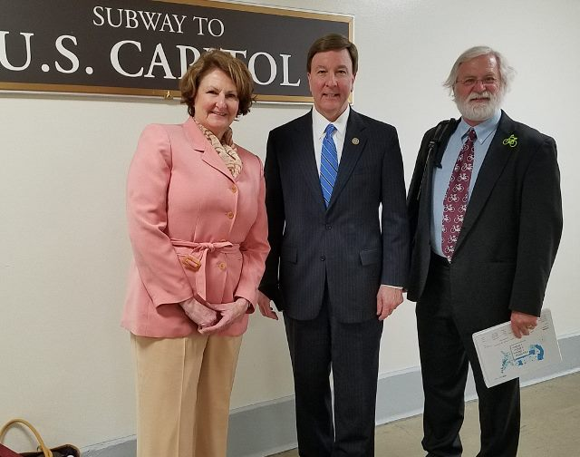
Lobby Day
We caught Rep. Rogers in the hall for a photo. He said he’d support a Gas Tax hike for transportation funding.
Saw Rep. Byrnes and Sen. Shelby, only for a handshake.
We also met Rep. Aderholt, briefly.
But, we met with staff at all 9 offices.

Slide 17
Active Transportation Leadership Institute
Full day of advocacy training
About 45 attendees, facilitated by LAB at a local design office: Gensler
Cost $100, included lunch, well worth it
E-bike legislation has passed in TX, NC and CA. Important to define E-bikes as bicycles, rather than “motorized” vehicles or motorcycles
Equity/Diversity: Diversify the BOD, may help with grants to partner with more diverse groups like NAACP, AARP, tribal groups, Ride United, Black Girls Do Bike

Slide 18
Active Transportation Leadership Institute
Start-up Tips:
Hire Executive Director (ED) first, rather than other staff
Board of Directors must stay involved
Business plan and annual budget are essential
Funding is important, but membership is usually 20% or less. Events and major donations vie with contracts to provide most of the revenue. Contract work has diminished recently
Intercultural Development Inventory (IDI) was discussed; ask gender, race questions, as well as age, to understand organization composition
Make “Active Transportation” part of the mission and talking points to reach more groups for membership and funding.

Slide 19
Bicycle Mayor Initiative
I met the Bicycle Mayor of Keene, New Hampshire!
Turns out she was appointed by the actual mayor of Keene to answer the question: “Where can the bicycle take us?”
An organization out of Amsterdam, BYCS, is making the shift form car-centric to human centric cities possible through acting as a catalyst for breakthrough solutions around cycling.
Connected globally, Bicycle Mayors bring a world of innovation home.

Slide 20
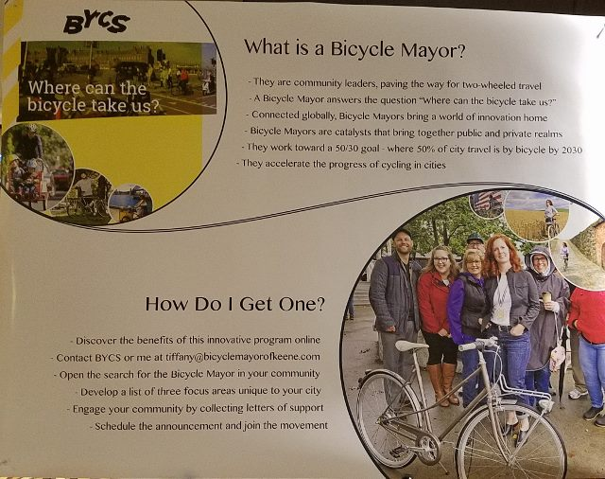
Bicycle Mayor Initiative
Bicycle Mayors are community leaders.
They accelerate the progress of cycling in cities.
Learn more about the benefits of this innovative program at: https://bycs.org
Bicycle Mayors are appointed by the city’s mayor.

Slide 21
Summary
Three members of the AlaBike board of directors attended the National Bike Summit in Washington DC March 5-7, 2018. For Shirley Lazenby, it was her first NBS. Kirk Iversen and Jamie Miernik have been to several. AlaBike has been represented at the NBS and participated in Lobby Day every year since 2003, where we visit all nine Congressional offices to advocate for safer, better and more infrastructure for cyclists.
Bicycle advocacy is “Bike Partisan” and the League ofAmerican Bicyclists (LAB) does a great job hosting the NBS.
This year we learned a lot about a possible federal gas tax hike, electric bikes, infrastructure planning, bike tourism and many more topics.
We also learned and were able to experience a bit about docked versus dockless Bike Share, as well as met new and old friends, and enjoyed a few “car-free” days in Washington, DC.

